Slide 1
The Law of Cause & Effect
Part 1

Slide 2
This is a true story. There was a young couple from Japan living in the USA. The husband was busy with his work and was often away from home on business. One such time the wife had an affair with a white American man, and got pregnant. She kept the affair secret with the hope the baby would be born Asian in appearance.

Slide 3
To her relief, the baby girl was born completely Asian looking, and her secret was safe. The girl grew up and later married an Asian man. She became pregnant and had a baby. To her shock the child was born with all the feature of a white person. The secret of her mother’s affair was exposed after more than twenty years.
Are you shocked by this story? ☺

Slide 4
"Seeds that are sown will never fail to grow. Seeds that are not sown will never grow."

Slide 5
Everything in this world, without exception, has a cause, and there is a result for every cause. This is the Law of Cause and Effect that I will explain about now.

Slide 6
Buddhism was taught by Sakyamuni Buddha 2600 years ago.
Buddha taught Buddhism for 45 years. His teachings are contained in more than 7000 sutras.
The Law of Cause and Effect runs through all the sutras.

Slide 7
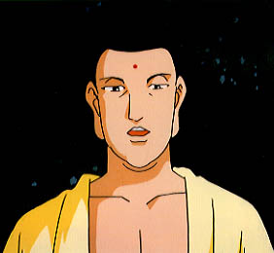
The foundation of Buddhism is the Law of Cause and Effect
Sakyamuni
The Law of Cause and Effect
(The foundation of Buddhism)
All the teachings of Sakyamuni are recorded in what are known as sutras
The Law of Cause and Effect permeates all these 7000 sutras
Simply put, the Law of Cause and Effect teaches that…
Seeds not sown will never grow
Seeds sown will never fail to grow
Notes:
P10
The foundation of Buddhism is the Law of Cause and Effect.
All the teachings of Shakyamuni are recorded in what are known as sutras and what permeates all these sutras is the Law of Cause and Effect.
There is not even a single sutra where the Law of Cause and Effect is not taught.
I think you understand why it is said that Buddhism can never be understood without understanding the Law of Cause and Effect.
The Law of Cause and Effect is the mechanism by which our fate is being determined.
In plain words, it is as the following:
Seeds not sown will never grow.
Seeds sown will never fail to grow.
Let me explain more in detail now.

Slide 8
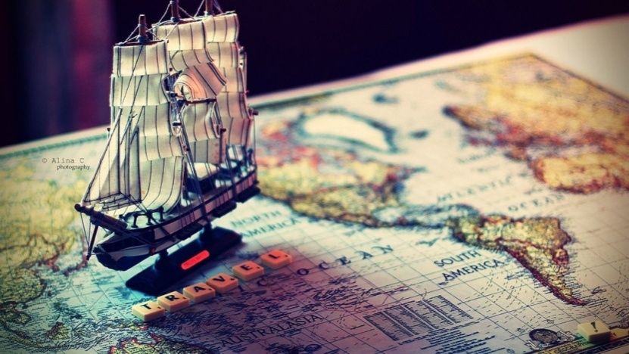
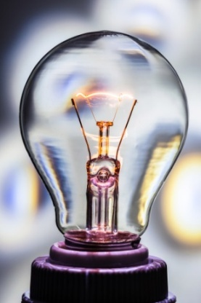
The foundation of Buddhism is the Law of Cause and Effect
Something discovered
by Sakyamuni Buddha
(Not something created or invented)
The “Law” taught in Buddhism
INVENT or CREATE
DISCOVER
Notes:
P9
But Buddhism never needs to be changed.
It was valid when Buddha was alive in India 2600 years ago, it is valid today, and will be in the future.
Let me add that the “law” taught in Buddhism was not something created or invented by Shakyamuni Buddha but rather discovered by him.
For example, Edison INVENTED the light bulb and Wright Brothers INVENTED the airplane. Bell INVENTED telephone.
In other words, to INVENT or CREATE something means to come up with something that did not exist before.
Although iPhone is still a phone, but because the old-fashioned concept of a phone was overturned by Steve Job’s invention, he used the word “reinvent.”
As you can see, to invent means to create something new, something that did not exist before.
In contrast, Columbus is said to have discovered America.
He did not create or invent America.
America existed even before Columbus found it.
Similarly, to find something that already has existed is to say to have discovered it.
Shakyamuni Buddha taught the “law,” which he had discovered.
In other words, whether Shakyamuni appeared 2600 years ago or not, there exists a truth, which happened to be discovered by Shakyamuni through his enlightenment of the Buddha.
And then he taught about it, which is now called as Buddhism.
This is why Buddhism is also known as Buddha Dharma or Buddha’s law.

Slide 9
The foundation of a tree for example would be the root and trunk.
For this tree, there is nothing that is more important than its root and trunk. If the roots are cut, the tree will die. If the trunk is cut, the tree will fall.

Slide 10
Suppose this is a tree called Buddhism, then the Law of Cause and Effect is the root and the trunk of the tree.
We can see how crucial it is to understand the law of cause and effect in order to understand Buddhism.

Slide 11
Meaning of the word “Law”
Law is a truth or principle, it is something that does not change regardless of time and place.

Slide 12
Time: Millions of years ago, today and millions of years into the future, the Law is something that does not change
Place: in the Philippines, in Japan, in the United States. Even if you fly into outer space the Law always works.

Slide 13
Such a thing that does not change is called “Truth.”

Slide 14
Something that was considered as true in the past, but it is not considered as true any longer cannot be called a Law.
Something that is considered correct in one country, but not in another country also cannot be called Law either.

Slide 15
The “Law” works in throughout
the 3 worlds and the 10 directions
10 directions
(Everywhere)
3 Worlds
(Always)
Up
North
Past
Present
Future
West
East
South
Down
Notes:
P7
What is the meaning of "Law?“
The Law penetrates the 3 Worlds and the 10 directions.
The 3 Worlds are the Past, Present & Future.
10 Directions means north, south, east, west, and the 4 points in between and up and down.
In other words, it refers to everywhere.
Law is something that does not change regardless of time and place.
Hundreds of thousands of years ago, today and hundreds of thousands of years into the future, the Law is something that does not change throughout the past, the present and the future.
It was true in the past.
It is true in the present.
It will be true in the future.
It is something that operates at all times.
Also, it is something that operates anywhere: in the Philippines, in Japan, in the United States.
Even if you fly into outer space the Law never fails to work.
This is called the Law.
Such a thing that does not change is called Law.
Something that was considered as truth in the past, but it is not considered as truth any longer cannot be called a Law.
Something that is considered correct in Japan, but is not accepted in another country also cannot be called the Law.
In Buddhism, the Law is something that never fails to work throughout the three worlds and the ten directions.
The three worlds are the past, present and future world.
The 10 directions refer to everywhere, the 8 points of a compass and up and down.

Slide 16
In Buddhism, the Law is something that never fails to work throughout the three worlds and the ten directions, all times and places.

Slide 17
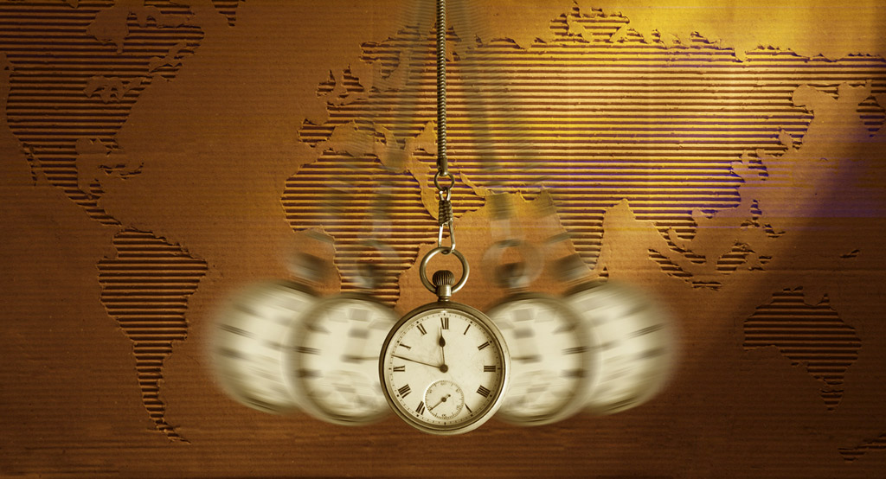
Therefore what is taught in Buddhism is valid anytime and anywhere, because the teaching is based on the unchanging Law of Cause and Effect.
Notes:
P8
So, it means that the Law of Cause & Effect works always and everywhere.
Something that was accepted years ago, but is not accepted anymore is not a law.
Also, something that works in one country, but not in another country is not a law.
What is taught in Buddhism is valid anytime and anywhere, because the teaching is based on the Law of Cause & Effect, which is valid anytime and anywhere.
Social laws and constitutions change from country to country, and change over time.
That’s because they are man-made.
For example, the laws when there was no Internet and the laws today when we have Internet are different.
Man-made laws must be changed to suit the necessity of modern times.
Also the laws of the USA differ from the laws in Japan.
Also the laws vary from state to state within the USA as well.
Assisted suicide for example is legal in Oregon but not in other states.
Same-sex marriage or abortion too is legal in some states but not in others.
As you can see, the constitution or national laws vary according to time and place.

Slide 18
We look for the cause because we know that when something happens there must be a cause.
Never once in a million or a billion cases is there never a cause. There is no exception. There is absolutely no way for a result to occur without a cause.

Slide 19
‘Cause and Effect’
There is never a result that occurs without a cause.
Ex. An airplane crash occurs and a tremendous amount of money and time are spent in order to find out the cause of the crash.
By finding out the cause, we try to avoid a further accident.

Slide 20
"This has happened by accident.”
When we say "accident," what we mean is that we don't know why this has happened.
However, if we mean that it occurred without a cause then we are mistaken.

Slide 21
There are many cases that the causes cannot be found even though they exist.
This means that that we cannot find the cause. It does not mean that there is no cause. These are two completely different statements.

Slide 22
There is always a cause.
A Cause is like a seed.
A farmer plants various seeds in the field. If he wants tomato, he will sow tomato seeds and he will harvest tomato. Tomato is the result. What he planted were seeds. What grows is the effect.

Slide 23
If he sows watermelon seeds, watermelon will grow. What grows depends on the nature of the seed.
However, if he doesn't sow seeds, nothing will grow no matter how many times he goes to the field looking for something.

Slide 24
Buddhism, teaches us in detail about the matter that concerns us the most, the relationship between the cause and the effect of our fate (destiny).

Slide 25
Seeds planted will surely grow;
Seeds not planted will never grow
Buddhism teaches about
“the Law of Cause & Effect about our main concern - our destiny”
How is our destiny created?
Notes:
P12
Buddhism teaches about the Law of Cause & Effect about our main concern - our destiny.
We all want to know if we will be happy or unhappy in the future.
We want to have a good destiny.
We want to avoid a bad destiny.
How is our destiny created?

Slide 26
The Meaning of Destiny
Why I was born in the country I was born in? While there are 7.5 billion people on earth, the population of my country is only .… million. It was my destiny that I was born in….

Slide 27
Destiny” cont’d
Among the 7.5 billion people, some were born in India, or China. They had the destiny of being born there. Those who were born in the United States had the destiny of being born in the USA.

Slide 28
Depending on the country we are born in, people’s destinies can vary dramatically. Why are there such differences in destines?
There is a cause for it. Nothing happens by chance.

Slide 29
Destiny (examples)
The country I was born in
As a man or woman.
To the parents I was born
With certain talents
Intelligence
Physical features

Slide 30
A woman who is born very beautiful might have the good fortune of getting married to a rich man.
Someone is born into a rich family and as a result their destiny in life is much different to many others.

Slide 31
Who or what determines this?
This issue of destiny is what we want to know the most. Why?
Because the reason we are living is to seek happiness.

Slide 32
Why do we live?
Why were we born? Why are we living? The purpose of life is to attain happiness, is it not?

Slide 33
Happiness is a good fate. Everyone wants to receive good fate, and avoid a bad fate. Therefore what we want to know the most is what determines a good fate of happiness, or a bad fate of misfortune.

Slide 34
Yet we don't know how our destiny is determined or why we experience good luck or bad luck.
We are ignorant about this very crucial issue.

Slide 35
Buddha taught the answer to the crucial question of destiny in the following way:
Good cause, good effect
Bad cause, bad effect
My cause, my effect
This is Sakyamuni Buddha’s statement on the causality of destiny.

Slide 36
This means:
A good cause brings a good effect
A bad cause brings a bad effect
My own cause brings my own effect

Slide 37
“Cause” refers to “DEED” or “ACTION.”
“Effect” refers to “FATE” or “DESTINY.”

Slide 38
“Good causes produce good effects” means that good actions bring good results.
Good results refer to a destiny of good fortune or happiness.
Happiness or good fortune is born out of good deeds.

Slide 39
“Bad causes produce bad effects” means that bad actions result in bad effects.
Bad results refers to a destiny of misfortune or unhappiness.
Bad luck or unhappiness is born out of bad deeds.

Slide 40
3 Sources of actions (karma)
Action of the MIND
Action of SPEECH
Action of the BODY

Slide 41
Every day we sow many seeds through the actions of our mind, speech and body.
When spring comes, farming families prepare to plant and raise rice. The essential thing is to sow the rice seeds and nurture the seedlings.

Slide 42
Having prepared the fields and filled them with water, they find that in a single night the fields are transformed into paddies, that, mirror-like, reflect the blue skies. The farmers must replant the seedlings, use fertilizers, make great efforts to week the fields, and protect the precious rice from damage from wind or water.
Then, in the autumn, the whole area is filled with golden ears of rice.
The efforts of the farmers in sowing rice seeds and then replanting the seedlings with great labour are rewarded with the autumn harvest.

Slide 43
But it is not only farmers who sow seeds. Sakyamuni teaches that we all sow many seeds every day. By “seeds” he means the various acts of our body, speech and mind.
Examples of planting seeds with our body would be practicing hard to acquire some skill, being careful to exercise, cleaning and straightening up our rooms, trying to greet people with a smile, keeping our promises and listening to what others have to say.

Slide 44
Examples of sowing seeds through speech include greeting others pleasantly, thanking others, and praising the strengths of others. Sowing seeds through the mind includes acts such as avoiding excessive self criticism, being considerate of others, and resolving to be grateful towards others.
Of course not just these but all our actions of body, speech and mind can be called “seeds”, so we really do sow many seeds each day.

Slide 45
Cause refers to “deed”
Effect refers to a “result”
Good deed
Good result
Bad deed
Bad result ☹
Own deed
Own result

Slide 46
A good cause or deed will only produce a good result/destiny.
A bad cause or deed will only produce a bad result/destiny.
This is the unchanging universal Law.

Slide 47
To say it another way…
A bad result or destiny can never come from good actions, just as a good result or destiny can never come from bad actions.

Slide 49
When we know the kinds of seeds we have planted, we will know what will grow in the future.

Slide 50
Also, if we examine what has grown, we will know what seeds we planted in the past.
As you sow, so shall you reap.

Slide 51
Whether good or bad, whatever happens to us is generated by the seeds we have sown. This is what Buddhism teaches.

Slide 52
Are there exceptions to the Law?
“I am getting the result of someone’s else action.” Can this happen?

Slide 53
One never reaps the results of the actions of others.
The seeds that I plant will never be reaped by others.

Slide 54
If I practice playing the piano. I will become more skillful at the piano, not my siblings, or best friend.
If I drink alcohol, it is me who will get drunk, not the person next to me.

Slide 55
An example where people might think there is an exception to the Law…
There is a very good wife who is married to a bad man. He gambles his earnings; drinks too much, and abuses his wife. She lives a hellish existence because of him.

Slide 56
How does such an example apply to the Law of “own cause own effect”?
If she is good, why is she getting a bad result?

Slide 57
The cause is that she decided to marry him. Her own deed of getting married is the cause of her present suffering. Her husband, then, is the condition for her present suffering, but not the cause.

Slide 58
Does the husband bear any responsibility for her present suffering? Yes, he does. Bad conditions must be corrected.

Slide 59
What is “condition”?
The Law of Cause, Condition and Effect. This is the complete expression of the Law of Cause and Effect.
When causes and conditions are combined, for the first time a result will come about.

Slide 60
When certain conditions (place, person etc) come along, then destinies in the form of good luck or bad luck appear.

Slide 61
Condition

Slide 62
Rice
The cause and condition of rice.
There must be a seed. This is the cause.
When the seed is combined with the right conditions (water, sunlight, temperature, farmer’s work etc) the result of rice that we can cook and eat grows.
Rice is the result. The cause was a seed.

Slide 64
When cause and condition are combined the result will appear without fail.

Slide 65
If there is a seed but no conditions, nothing will grow.
If there are conditions but no seeds, nothing also will grow.

Slide 66
Therefore, "Condition" is something which assists the seed to grow into a result.

Slide 67
In the story of the good wife and bad husband, the husband is a bad condition but not the cause. Due to a combination of her bad cause and the condition of a bad husband a very bad outcome appeared. Therefore we can see that even this example is “own cause own effect.”

Slide 68
You might think that if this man is so bad, why did she marry him.
In fact this woman's parents had been opposed to her being with this man and warned her that he was no good for her. Her friends didn’t like him either and wanted her to look for someone else. But despite these warning she married him anyway. Why is this? Because she fell in love with him.

Slide 69
What caused her to fall in love with him? Some say it’s unexplainable. However, there must be a cause why someone falls in love with a specific person because we don’t fall in love with every person we meet.

Slide 70
The actual cause that led to this woman falling in love with her husband was an invisible power.
This invisible power is called in Buddhism, “Karmic power.”

Slide 71
“Karmic power” is invisible energy that is generated by my own deeds.
Our deeds/actions are called “karma” and my deeds remain in me as this invisible karmic energy.

Slide 72
Deeds are like seeds, and there are seeds for everything that grows.
In Watermelon, a small seed is the origin and it contains the invisible energy that will produce a number of big watermelons. It’s the invisible energy within that has the power to create.

Slide 73
A tree in winter looks dead. It has just bare branches. Yet from these bare branches, when the right condition (spring) comes around, the flowers and leaves will appear.
The cause is the invisible energy, and the condition is Spring.

Slide 74
However, even when Spring comes around, if there is no energy in the tree nothing will happen.
Again, if there is no cause/seed, then nothing will appear.

Slide 75
Buddha taught that good deeds are stored within us as good karmic energy, while bad deeds are stored as bad karmic energy.
When the appropriate condition comes around a result, good or bad, will appear.

Slide 76
Therefore Karmic power is the invisible energy that generates our happiness or unhappiness, the power that produces good fortune or misfortune.
Where is this energy stored?

Slide 77
It is stored in our eternal life.
This is known as the Alaya mind. Alaya refers to a storehouse or safe.

Slide 78
Summary
A good fortune or happiness is brought about by good actions, and a bad fortune or unhappiness is generated by bad actions. Whether good or bad, whatever happens to us is generated by the (good or bad) seeds we have sown.

Slide 79
Once we understand the law of cause and effect, we cannot help practicing good deeds and avoiding bad deeds.
To be continued.

Slide 80
End

