Slide 1
By making others happy, I become happy
The meaning of the Buddhist term :
Jiri Rita

Slide 2
The spirit of Buddhism is benefiting others, benefitting myself
Sakyamuni Buddha instructs us to think of ways to give to others, rather than how to get from others. He teaches us to always consider what, when, how, and to whom to give and to put it into action. This is the practice of good deeds in the form of “giving”.

Slide 3
Filled with insatiable desires, we tend to believe that if we give money or materials to others, we reduce our share and be unhappy. However, Sakyamuni Buddha teaches that it is not so, for by giving, the giver and the receiver alike gain happiness, emphasizing the importance of offering.

Slide 4
Jiri Rita is the opposite of Gari Gari
Gari gari mean “for my gain.”
It is thinking about oneself, not others.
When we seek after our desires, we are thinking only of ourselves.
To think of others is to practice kindness. It is to go against desire.

Slide 5
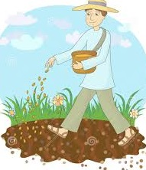

A Farmer must give first in order to Get
Step 1. Cause: Giving
Step 2. Effect: Reaping

Slide 6


Giving before we receive
Give the vehicle fuel to get to drive
Give the fire wood to get the heat

Slide 7
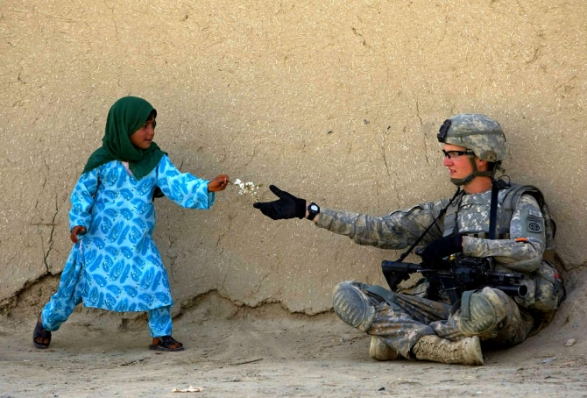
‘Benefiting others, benefitting myself.’
The very act of giving and pleasing others becomes your own joy. This mindset is called ‘Benefiting others, benefitting myself.’
This is the mindset or spirit of Buddhism.

Slide 8
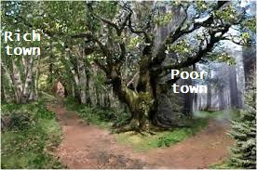
There is an anecdote from Buddha’s life. One day, Sakyamuni Buddha set out seeking alms (asking for donations) with disciples. After a while, they came to a fork in the path. The left path led to a town of rich people, and the right path, to a village of dire poverty.
Which path do you think Sakyamuni Buddha took? The answer is the right path. Do you know why? Lets read more of the story….

Slide 9
“Pardon me, Sakyamuni Buddha, it seems that you are taking the wrong path,” said one of the Buddha’s disciples. “This path leads to a village of extremely poor people. After the recent famine, some people have starved to death. In such a poverty-stricken village, I doubt that people are able to make offerings. If we take the other path, which leads to the town of merchants and landowners, there will be more people willing and able to give.”

Slide 10
On hearing this, Sakyamuni Buddha replied: “I am not taking the wrong path. I know well enough that this path leads to the village of the destitute. The poor must make offerings. They are impoverished to the point of starvation, because they were selfish and did not practice the virtue of almsgiving in their past lives. Those who practiced good deeds of offering are born to prosperous families and those who did not are born to families of lesser means. They are reaping the results of what they sowed in the past.
If the poor offered a single grain of rice and gained virtue, they could escape from poverty. It is said, ‘Better the pauper's single candle than the rich man's ten thousand candles.’ The value of an offering does not depend on its amount. The poorer one is,
the more one needs to practice charity.”

Slide 11
The disciples nodded in deep agreement. If Sakyamuni simply wanted to receive food for his meal, he could have gone to the town of the wealthy. Needless to say, there was no need for that; born to a royal family, he had no shortage of food and materials.
By going on alms rounds, Sakyamuni, in truth, allowed the poor to make offerings, however miniscule they may have been. The results of good deeds will always manifest upon the good-doer.

Slide 12
It is said that Sakyamuni stayed in the village of the poor for over ten days and gave sermons. In return, he received rice porridge made from what little rice the villagers could offer.
What is the reason those poor villagers were born to such a situation? Sakyamuni Buddha says that it is because they were not kind in regards to giving in their past lives.

Slide 13
A Dog Program in the Prison System
Within the prison system in America, there are many rehabilitation programs for the prisoners to help them to return to society. Many of them include work or study programs.
But there is still a serious problem with these prison programs because the second offense rate remains quite high. Nearly 40% of these inmates come right back to the prisons again.
However, one particular prison in America introduced a special program.
Once enacted, the crime rate suddenly decreased. At this prison for 15 years, no one came back to the prison again. The program was introduced to Japan too.
The program ordered a prisoner to take care of a dog.
Prisoners had to live together with the dog, even eating and sleeping together.
Many people who had murdered didn't have a lot of experience taking care of other people, let alone animals. Since they came from such unfortunate environments they were selfish and thought only about themselves.
In the program, inmates cared for the dogs for a total of three months.
The dogs had been previously abandoned or abused. These animals were close to being put to sleep. After three months, if the dog was well behaved, it was brought to a shelter where people could adopt them.

Slide 14
By building a caring relationship with the dogs, the prisoners rediscovered what kindness was.
One prisoner said,
"When I was in jail, the dog looked at me sadly. The dog’s eye reminded me of the time when my brother looked at me in the old days. I am here because I almost killed somebody. I used drugs and I was violent. However, I don't want to go back to that life."
Another inmate said,
"I am self-centered and I didn’t care about others. However, when I took care of the dog, I realized that they also have the same feelings as people. Wanting to take care of others is important."
After the three months, the dogs and prisoners had to be separated.
The dogs were then brought to their new home.
One prisoner even cried because of the sad departure.
"Actually, I want to take care of the dog more, but if the dog is happy then I am OK. If the dog was not here, he might have been put down. I hope he will be happy."
The prisoners were wishing happiness for the dogs they cared for. Their eyes took on a brilliant shine, and their faces no longer harbored vicious feelings.

Slide 15
So, here is a question. Did the prisoners help the dogs? Or did the dogs help the prisoners?
The answer is both.
This is known as Jiri Rita: "by helping others, I help myself."
By making others happy, I make myself happy.
Even though we humans are weak, having the mind of kindness toward those in need can make us stronger.
It is difficult to change myself for my own profit. But it is possible to change myself for others.
The mind of giving is the source to the power of living.

Slide 16

A Dog Program in the Prison System

Slide 17
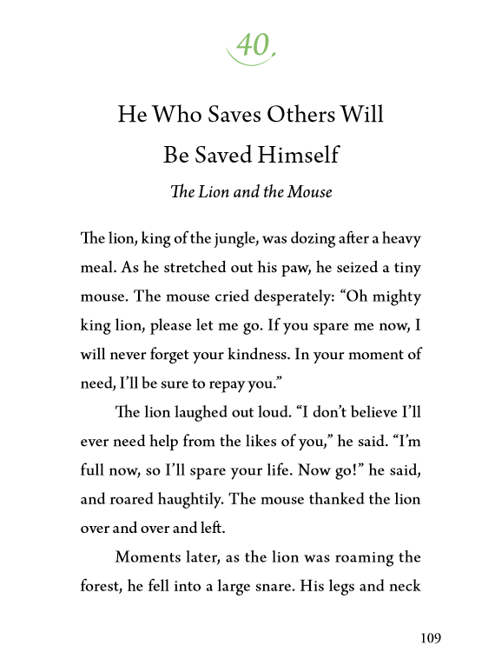
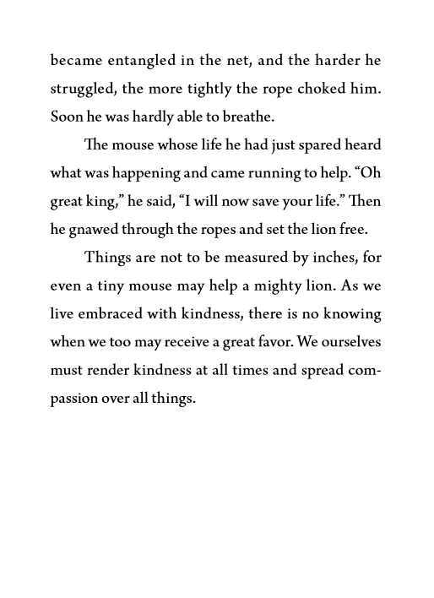
From the book Something You Forgot

Slide 18
To practice the 6 good deeds is to think of others
The 6 Good Deeds
Jiri Rita
Kindness
Keeping a promise
Patience
Making Effort
Self-reflection
Wisdom/self improvement
It’s kind to think of others, their comfort, wellbeing etc.
To keep a promise with someone is not wanting to disappoint them.
Patience is allowing someone their turn.
Thinking of others takes effort.

Slide 19
The right attitude towards giving— Try to forget about three things
Sakyamuni Buddha also teaches us the correct mindset of charity. When you give something, you should forget these three things:
１. I did
２. For whom
３. What I did

Slide 20
If you keep them in mind, you will be angry when you are not thanked. Thus, Buddhism instructs us to do good deeds and forget these three things. In doing so, your acts of offerings become genuine.
In contrast, offering while seeking and expecting the same in return is not true charity.
１. I did
２. For whom
３. What I did

Slide 21
Charity喜捨
The Japanese word for charity (Kisha) comprise of two Chinese characters,喜捨. The first character means ‘happily,’ and the second character stands for ‘to discard.’ Therefore, offering is something you do happily and forget about.

Slide 22
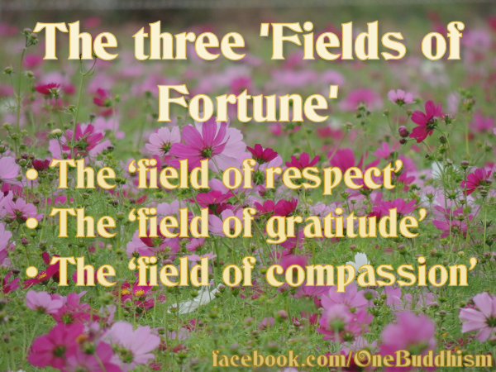
Whom to Give to
Those we respect: In Buddhism, Amida and Shakaymuni Buddha, True masters of Buddhism.
Those we feel gratitude towards: parents, teachers
Those we feel compassion for: those caught in disasters or misfortune

Slide 23
The Law of Karma is the governing Law of the Universe, taught Buddha
The 3 principles of the law are
A good cause brings a good result.
A bad cause brings a bad result.
The things that I do come back to me.
Therefore when we help others to be happy, by a result of the natural Law we ourselves must become happy. What we give out comes back to us, like for like.

Slide 24
Psychology Today: “Happiness Comes from Giving, Not Buying and Having”
If anything, it appears that there is a relationship between non-materialism and well-being. While possessing wealth and material goods doesn’t lead to happiness, giving them away actually does. Generosity is strongly associated with well-being. For example, studies of people who practice volunteering have shown that they have better psychological and mental health and increased longevity. Another study found that, when people were given a sum of money, they gained more well-being if they spent it on other people, or gave it away, rather than spending it on themselves.

Slide 25
So if you really want enhance your well-being - and as long as your basic material needs are satisfied - don’t try to accumulate money in your bank account, and don’t treat yourself to material goods you don’t really need. Be more generous and altruistic - increase the amount of money you give to people in need, give more of your time to volunteering, or spend more time helping other people, or behaving more kindly to everyone around you. Ignore the ‘happiness means consumption’ messages we’re bombarded with by the media. A lifestyle of generosity and under-consumption may not suit the needs of economists and politicians - but it will certainly make us happier.
Source: https://www.psychologytoday.com/blog/out-the-darkness/201501/happiness-comes-giving-not-buying-and-having

Slide 26
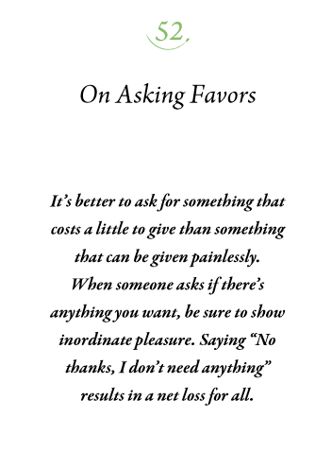

Slide 27
Review
Buddhism teaches us to give to others rather than thinking how to take from others.
To put ourselves before others is seeking after our desires.
A farmer gives seeds to the soil and receives a crop.
Sakyamuni Buddha gave the people of the poor town an opportunity to donate. By donating we are planting seeds of virtue that will grow.
A dog program in the prison system. Both the prisoner and the dog became happy.
When doing kindness, try to forget 3 things, I did, What I did, for whom.
Three fields to plant in…respect, gratitude, compassion.
The law of Cause and Effect is the governing Law.

