Slide 1
Kindness/Generosity
# 1 of the Six Paramitas (Good Deeds)

Slide 2
2 categories of Giving
Materials: money, donating clothes, food etc. Also 7 Kinds of non material giving.
Buddhism

Slide 3
7 kinds of non material giving
Gentle eyes
A Smile
Kind words
Sincere gratitude
Physical volunteering
Giving way
Sharing a meal/shelter

Slide 4
Giving Buddhism
Inviting someone to a Buddhist lecture.
Giving a book on Buddhism to someone.
Hosting a lecture in your home.
Sharing what you heard in a lecture: face to face, share online, text message, send a postcard.
Doing “a discussion of understanding” with fellow practitioners.
Introducing Buddhists teachers or practitioners to your family and friends.

Slide 5
Who are we doing kindness for?
When we give, we are also giving to ourselves, are we not?
Lets look at how we give to ourselves when we do good.

Slide 6
3 Principles of The Law of Cause & Effect (law of Karma)
Good Cause, Good Effects
Bad Cause, Bad Effects
Own Cause, Own Effect
Lets look more deeply at
Own Cause, Own Effect

Slide 7
Common views on own cause own effect

Slide 8
Own Cause, Own Effect
The seeds I plant will grow for me. They will only come back to me.
Example: Practicing table tennis, or a language.
In a bath, if you push the hot water away, it will come back
Example: Farmer planting (next slide)

Slide 9
Farmer planting seeds
It looks at though he is throwing away the seeds. But by giving them away, he receives a much large return.
Through his “kindness” of giving seeds to the soil he has received a great reward.

Slide 10
A lesson in “not doing”

Slide 11
How can we be prepared to avoid regrets?
“The law of sowing and reaping is the law of laws” said Ralph Waldo Emerson (1803 -82)
Learning about the law of cause and effect, the universal truth, the law that governs our destiny.

Slide 13
Why is it said that karma is like a boomerang?
A boomerang comes back to the person who throws it out.
It comes back in a circle.
Nature is cyclical

Slide 14
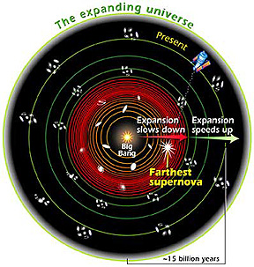
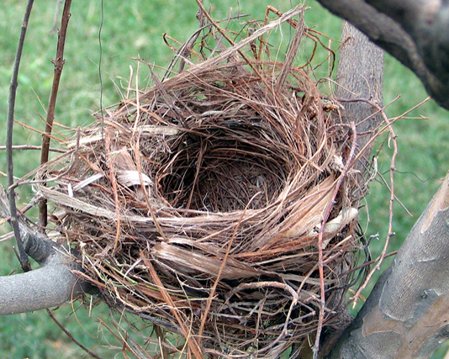
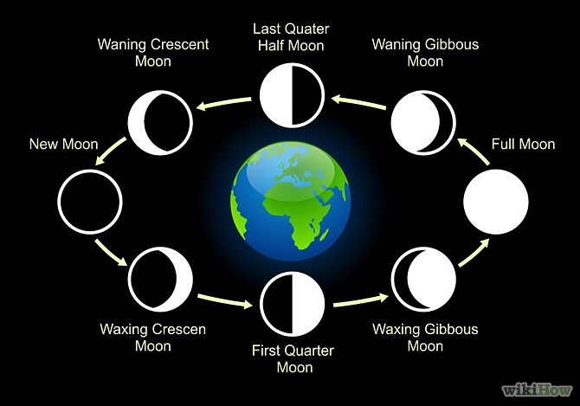
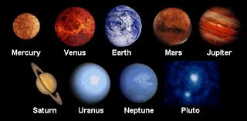

Slide 15
Black Elk Oglala Sioux Holy Man 1863-1950
“You have noticed that everything an Indian does is in a circle, and that is because the Power of the World always works in circles, and everything tries to be round..... The Sky is round, and I have heard that the earth is round like a ball, and so are all the stars. The wind, in its greatest power, whirls. Birds make their nest in circles, for theirs is the same religion as ours....Even the seasons form a great circle in their changing, and always come back again to where they were. The life of a man is a circle from childhood to childhood, and so it is in everything where power moves.”

Slide 16
Buddhism teaches about the “6 Good Deeds”
Kindness/Generosity
Keeping a promise
Patience
Making Effort
Self-reflection
Self-improvement/Wisdom

Slide 17
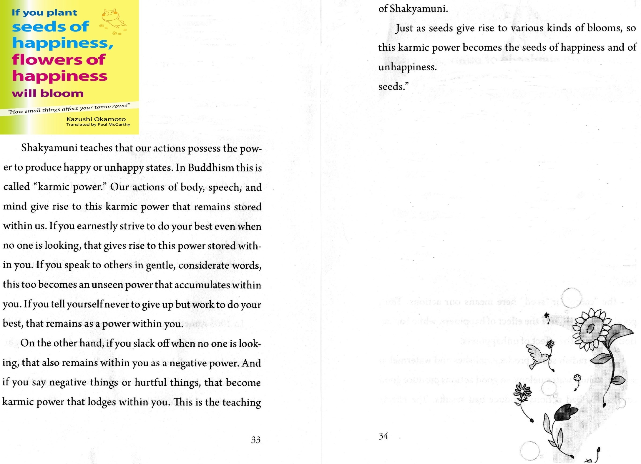

Slide 18
Chief Maquinna, Nootka (Native American tribe)
"Once I was in Victoria, and I saw a very large house. They told me it was a bank and that the white men place their money there to be taken care of, and that by and by they got it back with interest. We are Indians and we have no such bank; but when we have plenty of money or blankets, we give them away to other chiefs and people, and by and by they return them with interest, and our hearts feel good. Our way of giving is our bank."

Slide 19
“By giving, I receive”
This is the spirit of Mahayana Buddhism
“Jiri Rita”: “By giving to other, I make my self happy.” It’s putting other’s happiness first.
Opposite of Hinayana Buddhism:
Gari gari: “for my benefit only.” It’s putting my happiness first.

Slide 20
Please watch and write your thoughts

Slide 21
If there is no “cause” there is no result
“Seeds planted will surely grow.
Seeds not planted, will never grow.”

Slide 22
Dr. Emoto and “kindness” study on water: “Indifference does the greatest harm”

Slide 23
“The Secret Life of Water” by Dr. Emoto
[water] “changes its form completely depending on the person doing the observing. Water’s reaction will differ depending on whether the heart of the observer is filled with appreciation or with anger, and this difference is reflected in the formation of the crystals.” (p.131)

Slide 24
Dr. Emoto’s water crystals

Slide 25
The Sincere Heart Of Giving
“Once when the Russian writer Ivan Turgenev (1818-83) was penniless, a beggar came to his gates. Mortified that he had nothing to give, Turgenev ran out the front door, grasped the man’s hand in his, and called him “Brother” with tears in his eyes. Later the beggar confessed that never in his life did he receive any gift so precious.

Slide 27
Reading: “Do Good Regardless: The Stone in the center of town
Notes:
Keeping in mind this story in the next video

Slide 28
Wisdom Of The Native Americans
Before eating, always take time to thank the food.
When we show our respect for other living things, they respond with respect for us.

Slide 29
Kindness in action

Slide 30
Kindness in action

Slide 32
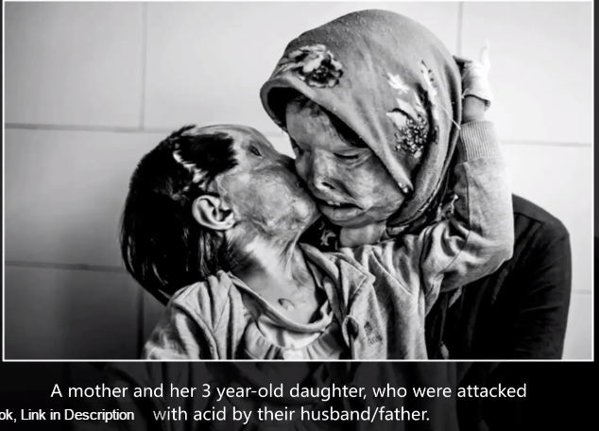
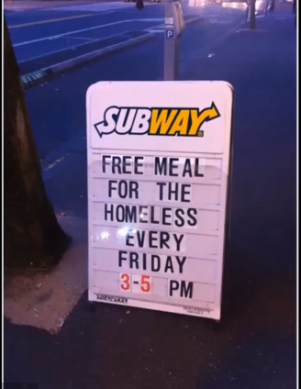

Slide 33
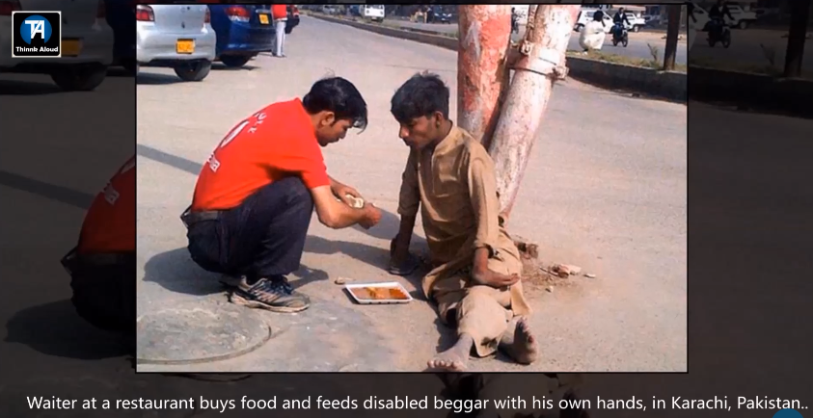

Slide 34
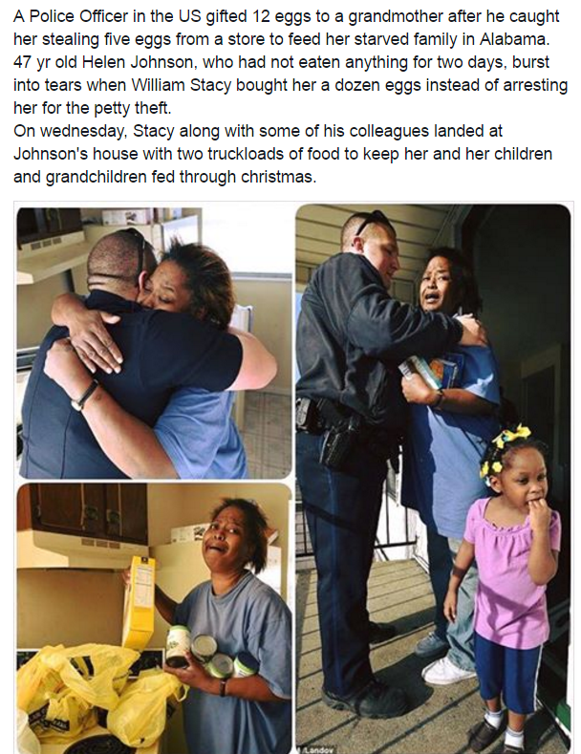

Slide 35
End

