Slide 1
Review
The Law is the foundation of Buddhism
Buddha taught Buddhism based on this Law. He did not invent it; he understood it precisely.
A Law is something that does not change over time and place, in the 3 Worlds and the 10
It is different from a human law.

Slide 2
Nothing happens without a cause; if there is no cause, nothing will happen.
Whenever an accident happened, people want to find the cause to prevent the same accident happening again because we understand there is a cause for everything.

Slide 3
“luck” does not exist, if we understand Luck to mean “no cause.”
Buddha taught about the Law to teach about human destiny.
Human destiny includes my birth, my gender, the country I was born in, the family I am born to, my talents, my appearance, intelligence and so on. These are all results that have causes.

Slide 4
There are 3 Principles to the Law: Good cause, good effect;
bad cause, bad effect;
own cause, own effect.
Cause refers to “action”; Effect refers “result” or destiny”
A good cause cannot bring a bad effect; a bad cause cannot bring a good effect.

Slide 5
What happens in my life is a result of my own causes. I never get a result from someone else.
For a result to appear there must be an condition.
A condition helps the cause to turn into a result.

Slide 6
Karmic Energy
Karmic energy is stored in our “eternal life.”
This eternal life is known as the Alaya mind.
Alaya = storage

Slide 7
The alaya mind is known as the real me. This is the “me” that never dies.

Slide 8
My actions remain stored in my Alaya mind as invisible energy.
When this energy meets with a condition, a good or bad destiny unfolds.

Slide 9
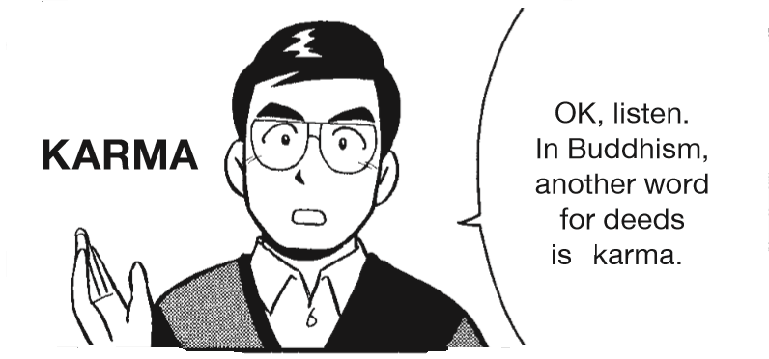
Our deeds remain as karmic power

Slide 10
In the case of watermelons or pumpkins, where is the invisible energy stored? In a small seed.

Slide 11
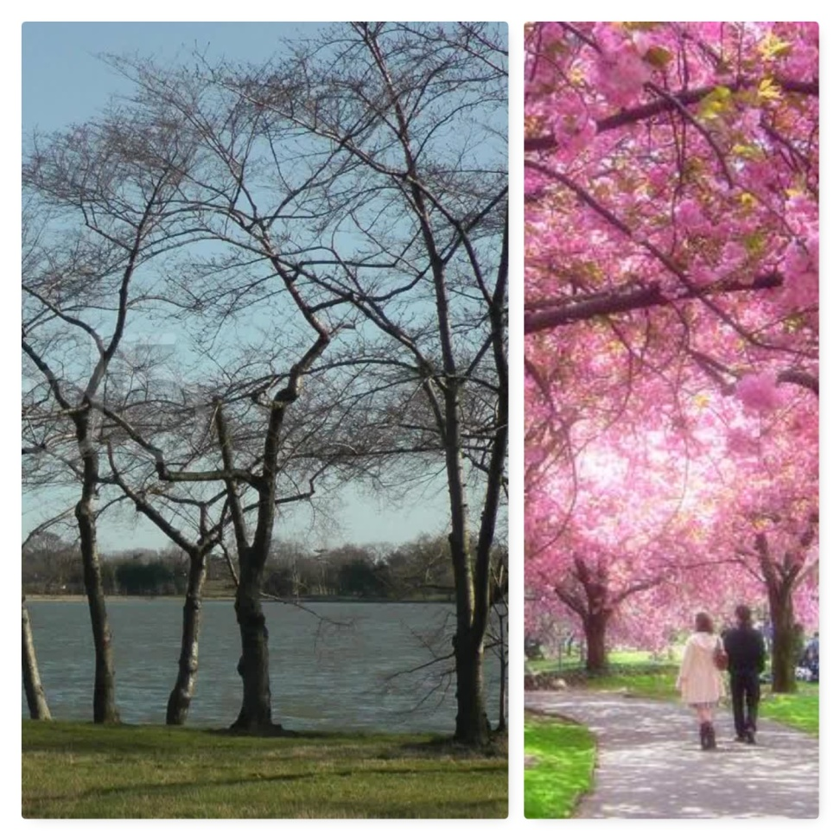
Cherry blossom trees are very popular in Japan
In Spring they are popular because of the flowers they produce.
However, in winter the tree is just bare branches, with no sign of the flowers. Where have they gone?

Slide 12
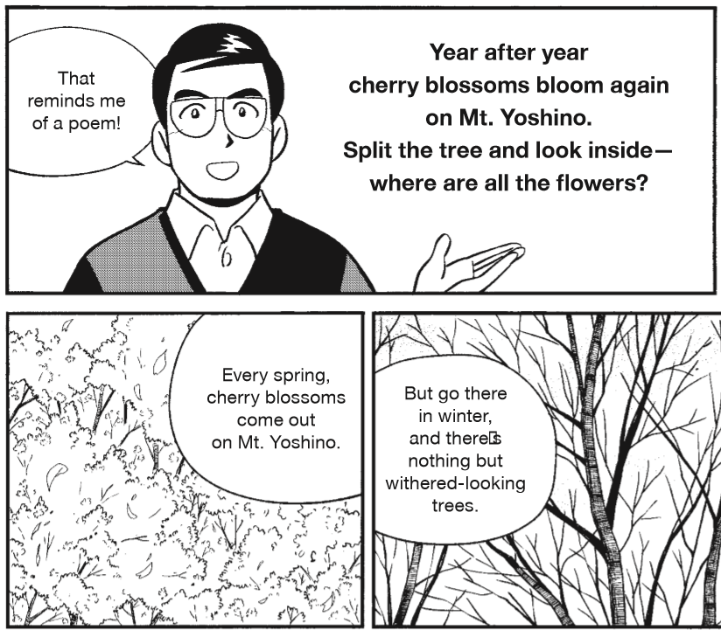

Slide 13
In winter the tree appears to be dead.
But when the right condition of Spring comes, the flowers will blooms again.
Why? Because of the invisible energy that remained within the tree in winter.

Slide 14
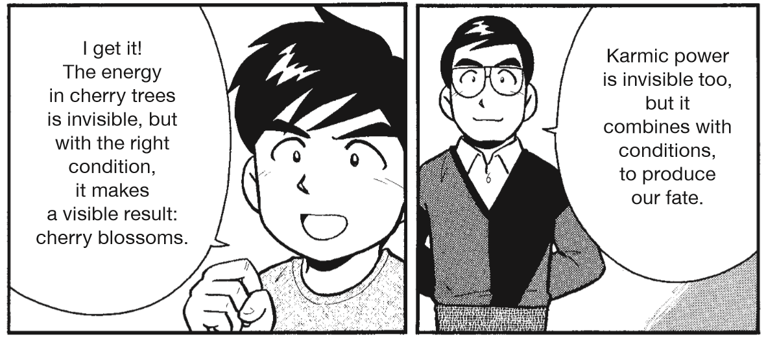

Slide 15
My destiny appears in the form of good results or misfortune depending on the nature of the energy (actions).

Slide 16
Example… Car accident
You are a good driver, obeying the rules.
You are hit by a carless driver.
How is such a case explained in terms of Karmic power and condition?

Slide 17
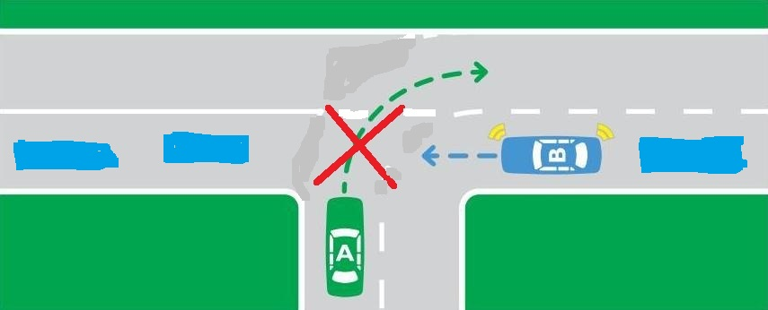

Slide 18
Sakyamuni Buddha said that karmic power is stronger than the pulling force of “100 elephants.”

Slide 19
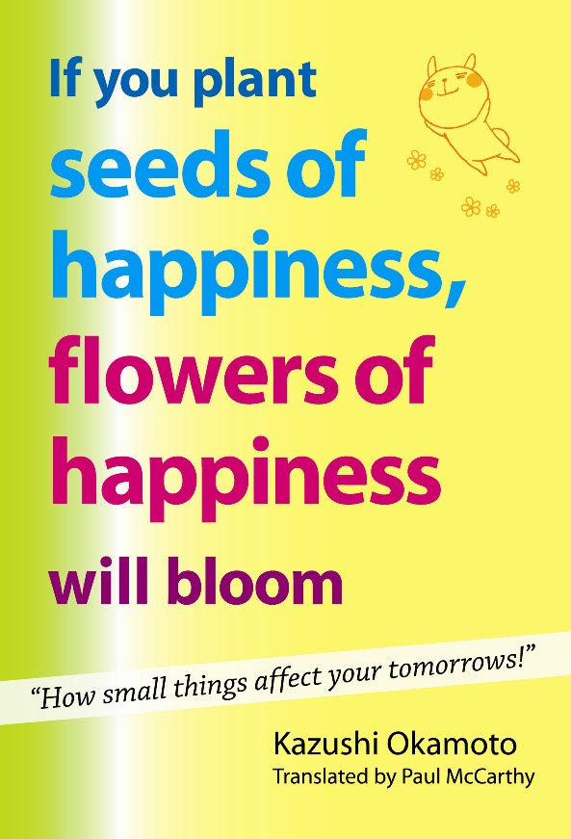
“Just as seeds cause flowers to bloom and fruit to appear, so our actions give rise to happiness and unhappiness.”
(Page 32 to 34)

Slide 20
If you plant seeds of happiness, flowers of happiness will bloom
In Buddhism our actions are also referred to as “karmic seeds,” the word karma/karmic referring, as we have seen to action of all kinds.
Sakyamuni compared our actions (our karma) to seeds that come to fruition. Why did he do so? Because just as seeds give rise to flowers and fruits, so our actions give rise to happy and unhappy states.

Slide 21
In 2005 something very strange grew out of the asphalt on a rod in Aioi City in Hyogo Prefecture (Japan). People thought it might be a weed, but then a white “head” popped out. It was daikon radish. A daikon radish has pushed its way through the asphalt and soon became the talk of the town. This strong willed radish was given the nickname “Dai-chan” and became one of the sights of Aioi.

Slide 22
Many people were moved and encouraged by the vital power that enabled the radish seed that was buried under asphalt to break through the hard road surface and bud. But radishes are not the only things that possess great power.
Sakyamuni teaches that our actions possess the power to produce happy or unhappy states.

Slide 23
In Buddhism this is called “karmic power”. Our actions of body, speech and mind give rise to his karmic power that remains stored within us. If you earnestly strive to do your best even when no one is looking, that gives rise to this power stored within you.
If you speak to others in gentle, considerate words this too becomes an unseen power that accumulates within you. If you tell yourself never to give up and to always do your best, that remains as a power within you.

Slide 24
On the other hand, if you slack off when no one is looking, that also remains within you as a negative power. And if you say negative or hurtful things, these become karmic power that lodges within you. This is the teaching of Sakyamuni.
Just as seeds give rise to various kinds of blooms, so this karmic power becomes the seeds of happiness and unhappiness. Thus are actions spoken or as “karmic seeds”.

Slide 25
Unless we sow seeds, nothing will grow. And that is why Sakyamuni tells us: “if you wish to be happy, sow the seeds of happiness.” Just as a small seeds the size of a grain of sesame becomes a towering tree, or a seed so light that it can be blown away by a breath can pierce the hard surface of the earth and put forth buds, or a seed discovered in the strata of earth that are thousands of years old can bloom if exposed to water and fresh earth, so too our actions possess tremendous power to produce both happiness and unhappiness.

Slide 27
Regarding my car accident, I was pulled to that exact spot, and at that precise time when the bad driver pulled out. My karmic energy pulled me there.

Slide 28
Karmic energy is our creation.
Everything occurs according to the Law of "One reaps what one sows."
It was my energy from my own past deeds that brought me and this bad condition together.
Therefore even this situation falls under “own cause, own effect”.

Slide 29
Destiny is mysterious
Why was I born in the country I was born in, and into the family I was born into?
Because I had those specific causes within me.

Slide 30
Why was I not born Chinese, or American?
I didn’t have the causes to be born there.

Slide 31
Who decided? Is it random luck?
Many people believe God decided our destiny.

Slide 32
How Buddhism answers
According to the law of cause and effect, before my birth, there must have been a cause for the result I received at birth. This result is my gender, the country I am born in, the parents I am born to, and so on.

Slide 33
To believe in the Law as the universal truth means to accept it for all situations, without exception.
To pick when to accept or reject, is not believing in the Law.

Slide 34
We cannot mold the Law to our thinking. We need to mold our thinking to the Law by understanding it.
The Law is something that is true all times and all places. It never changes. Something that does not change is called Truth.

Slide 35
Destiny of my Birth
What is the cause and condition of my birth?
When we understand it, we can then see what part my actions have in my own life.

Slide 36
Most people might think that the father was the cause and mother was the condition, and then I was born.
Is this right?

Slide 37
If this is so then, all the children from the same parents should be the same. No matter how many children the parents have, they all should be the same. Same gender, same appearance, same intelligence etc.

Slide 38
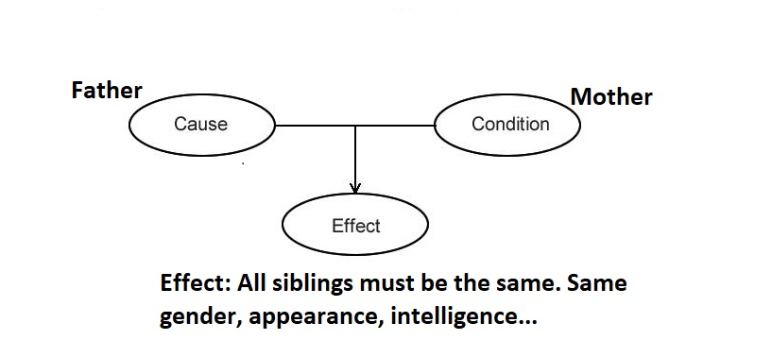
Yet as we know siblings are born very different from one another.

Slide 39
Why? Because the specific causes of each sibling, before they were born, were different.

Slide 40
How Buddhism answers
My cause combined with the condition of both my parents brought about the result of my birth. My parents were the condition, not the cause.

Slide 41
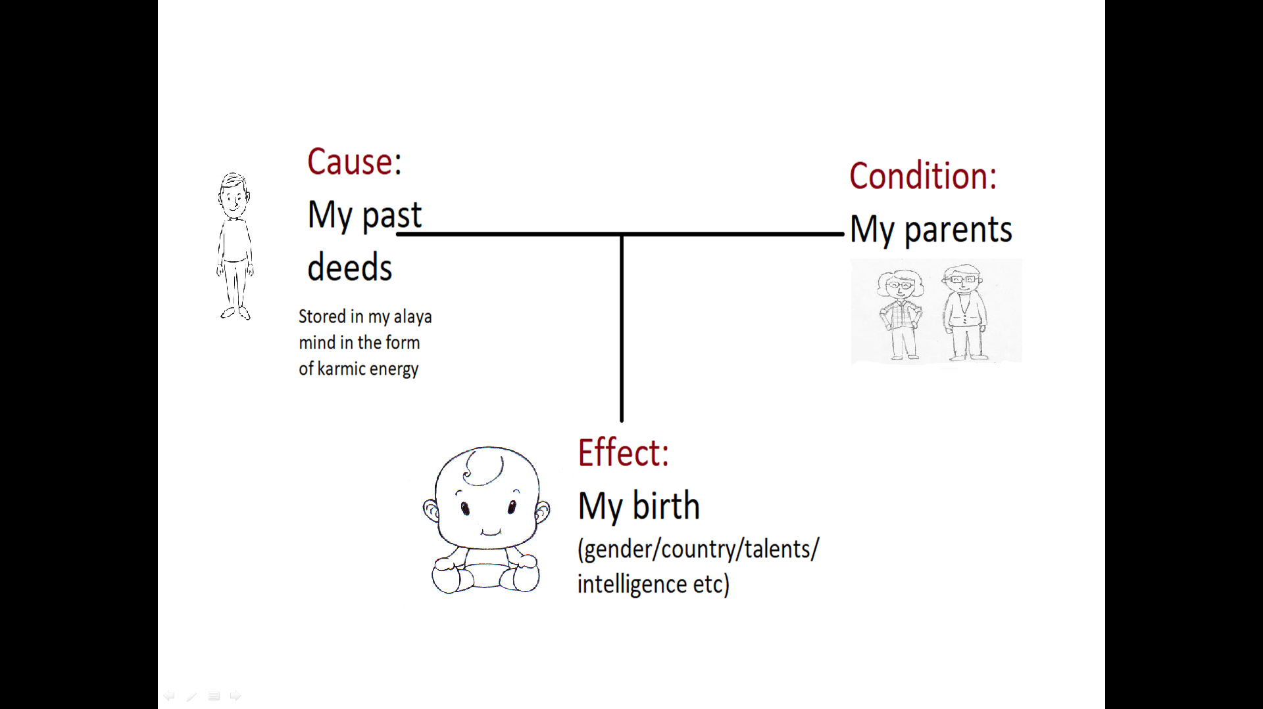

Slide 42
Why do you think that you became your parents' child? Why was I born in my country? The causes for such outcomes resided in the form of karmic energy in the Alaya Mind.

Slide 43
To understand this better, we need to know about my true life.
Our "Life" has been flowing like a stream from a distant past up to today.

Slide 44
Our physical body is like a bubble that forms on the surface of this stream. The bubble flows for a while and vanishes.
The stream of my life is my eternal mind, the Alaya mind, containing all my karmic energy.

Slide 45
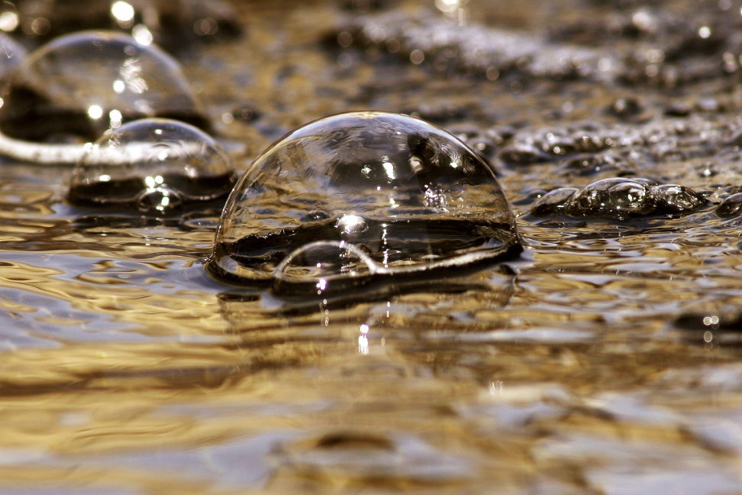
My life, from birth to death, is the bubble that forms from this eternal stream, and disappears after a while.
Birth BUBBLE Death
Past life
Next life

Slide 46
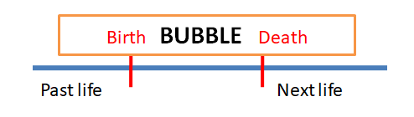
The stream continues moving into the future (the next world).

Slide 47
Previous life
“Today” exists because there was yesterday.
This month exists because there was last month.
This year exists because there was last year.
Something can only come from something.

Slide 48
In order to have this life we must have had a previous life.
Something cannot come from nothing.
My features, personality, character, talents etc are results from causes in a past life.

Slide 49
Simply speaking, the nature of one’s karmic energy becomes clear at birth.

Slide 50
Time flows in this way. It flows from the past to the present.
If one denies the past, how can the present exist? It is impossible to have the "present" without a "past.”

Slide 51
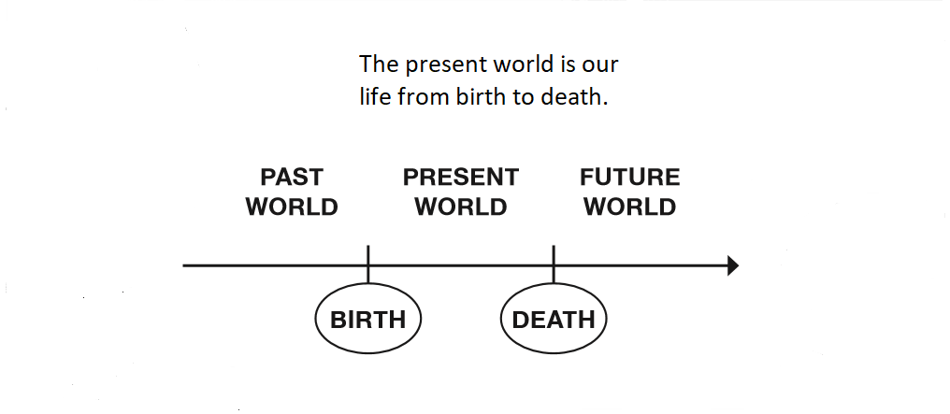
The Law spans 3 Worlds

Slide 52
Cause is known as "past karma," or past deeds.
The first baby is born normal, healthy, and blessed with everything parents would desire. Yet, the second baby is born physically handicapped. We can find this kind of examples everywhere.

Slide 53
Karmic timeline
Some planted seeds bear fruit right away. Other seeds bear fruit two or three days later. Still other seeds bear fruit one or two years later. There are also seeds that bear fruit twenty years later.
Remember the story from the start of the first lecture…

Slide 54
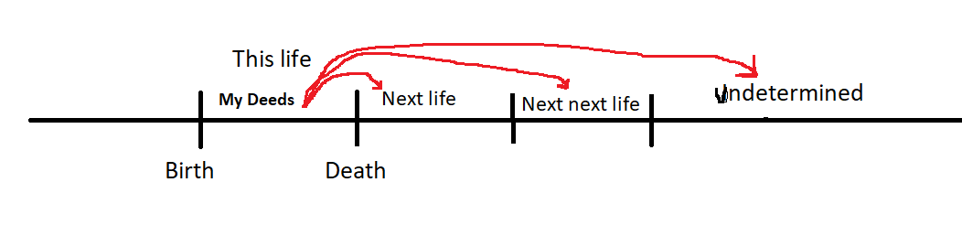
Next life. Next next life.
Undetermined life.

Slide 55
The horizontal line in the diagram represents our "Eternal Life”, the Alaya Mind, which is flowing invisible to the naked eye. There is something in us which is not our physical body. This something is our true "Self." The body is made up of trillions of cells. There is a power that keeps those cells together and this power is a sign that a person is alive. When this power is gone, a person is dead. The physical body disappears, but the true life of the person continues into the future containing their karmic energy.

Slide 56
My real “life” is always moving in the future and not limited between my birth and death.

Slide 57
There is never a case that results don't appear even though you have practiced the acts.

Slide 58
For example. A person is sentenced to death for the murder of 1 person.
And the person who killed five people, will they get the same result of being executed just once and that is all?

Slide 59
If 1 seed of a watermelon is planted, 1 watermelon will grow. 5 seeds will bear 5 plants.
A person who works for 1 day will get paid for 1 day. If they work 5 days they get paid for 5 days.

Slide 60
What is going to happen after we die? Some think that the world after death doesn't exist.
Consider this: After "today" we'll have "tomorrow." After "this year" ends, we'll have "next year." The present life ends when we die, so what happens after we die?

Slide 61
There is never a case where something that has existed up until now suddenly disappears.
There is never the case where we have "today," but we don't have "tomorrow?" Existence never turns into non-existence, it just changes form.

Slide 62
For example:
Burned wood turns into smoke and ash.
Boiled water turns in vapour.
A steam engine runs on burned coal, that boils water, that creates steam energy.
The original source has changed form, but has not disappeared.

Slide 63
The person who killed 5 people is executed. In the future, he has to harvest the consequences of killing the other 4 people. It has to be this way. This will be his destiny in future lives.

Slide 64
What about the person who killed 100 people?
In this life he is punished one time by being executed. What about the other 99 people.

Slide 65
The Law of Cause and Effect works in the 3 Worlds. This means that it is always working, before my birth and after my death. Therefore in the future he has to reap the results of the other 99 crimes.

Slide 66
The person who killed once might have been thinking, "I already killed one person. So, killing many more won't make any difference to me.“
Is this true? According to the LCE, absolutely not.

Slide 67
The Law works all the time
Someone might be thinking: "I practiced that bad act and nobody found out. I got away with it; in that case I will do it again."

Slide 68
The same applies to good deeds. You have practiced good acts but nobody noticed it.
“No one has seen the good actions that I have been doing. I won’t be rewarded for it. There is no point in doing them anymore.”
Is this correct thinking?

Slide 69
According to the Law of “one reaps what one sow’s” it is not correct.
One reaps what one sows regardless if the act has been seen or not, praised or not.

Slide 70
The complete name of the Law is the Law of Cause & Effect of the 3 Worlds
(The 3 Worlds are: past, present and future)
How did Sakyamuni Buddha explain about the relationship between the three worlds?
“If you would like to know your past causes, look at your present effects. If you would like to know your future effects, look at your present causes.”

Slide 71
Lets say you don't remember what kind of seeds you planted because you planted the seeds in darkness.
Then look at what grows in your field. If it is spinach that is growing, then you can tell that you must have planted spinach seeds.

Slide 72
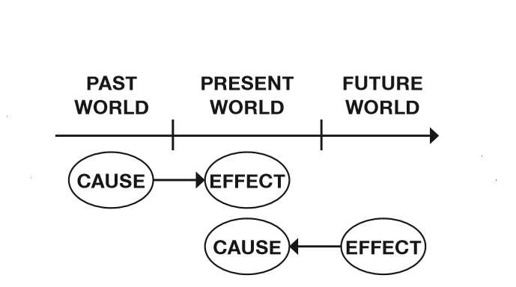
The present is the key to the past and the future

Slide 73
If you see watermelon growing, you know that you must have sowed watermelon seeds.
This is what is meant by "If you would like to know your past causes, look at your present effects."

Slide 74
What kind of results are you harvesting now?
If you examine your current situation, you can tell what kind of acts you practiced in the past.

Slide 75
What kind of effects will I get in the future?
Look at the seeds I am planting now, and I can tell.
What I am doing now will create my future fate. This is the meaning of “If you would like to know your future effects, look at your present causes."

Slide 76
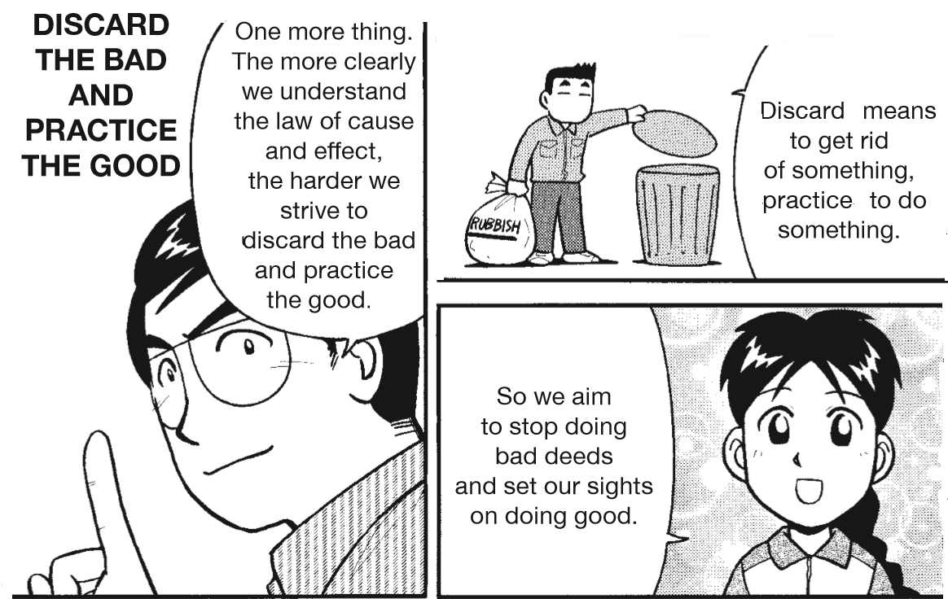
In Conclusion: Do Good; Stop bad

Slide 77
End

Slide 78

Images are taken from the book…

